Slide 1

DS Project Review: Desktop Application for Handwritten Digit Detection using Machine Learning
Made By:
Kushagra Singh
2K19/CO/204

Slide 2
Introduction
Humans have been writing important information on paper even before the advent of computer systems. However, storing such information has typically been very cumbersome and expensive. The use of these handwritten data on paper is generally limited to those around where it is stored, though several others across the globe might benefit from it. Digitizing such information and converting them to recognizable text allows search engines such as Google, Yahoo and Bing to be able to index and make them available for users around the world once they are uploaded to the web.
Applications of the automatic detection of hand written digits by machine learning models also include faster & efficient sorting and processing of postal mail & packages, faster processing of cheque payments in banks and identification & tagging of important information in hand written scripts without deploying large human resources.
Due to these numerous applications in various fields, this has a been a very popular topic of research & development over the years in both scientific & commercial fields.
Camastra & Vinciarelli 2001, Marti & Bunke 2001, Fenwa, Omidiora & Fakolujo 2012 etc. Are the works done in this field just to name a few.

Slide 3
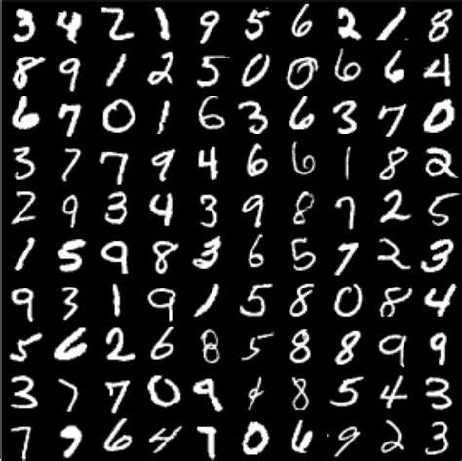
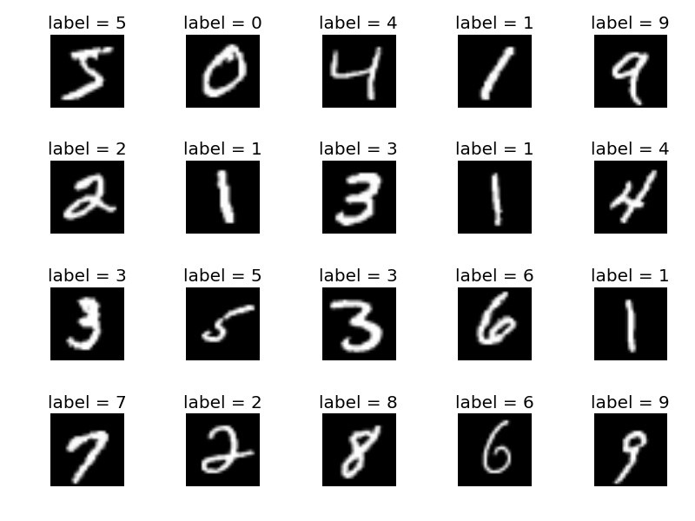
The MNIST Dataset
The MNIST database (Modified National Institute of Standards and Technology database) is a large database of handwritten digits that is commonly used for training various image processing systems. The database is also widely used for training and testing in the field of machine learning. The MNIST database contains a total of 70000 sample images (60,000 training images and 10,000 testing images) of digits 0 to 9 in varying handwriting styles & sizes.
Each image is represented by 28x28 pixels, each containing a value 0 - 255 with its grayscale value. It is a subset of a larger set available from NIST. The digits have been size-normalized and centered in a fixed-size image.

Slide 4
Feature Extraction Technique: Histogram of Oriented Gradients (HOG)
A feature descriptor or extractor is a representation of an image that simplifies the image by extracting useful information and throwing away extraneous information. This selection of only useful information from the image helps to make the machine learning and prediction process faster & more efficient as less amount of data being fitted to the model significantly reduces computation time & resources required.
We can define an image by the pixel intensities and intensities of the gradients of the pixels. These gradients work in the same way as they in detecting edges in images. Edges in an image are the main distinguishing factor as they’re the regions of intensity change in an image & the edges define the size, shape & orientation of an object. Therefore, detecting edges can lead to easy recognition & prediction of an image.
A HOG extractor computes gradients for different regions of an image. The value of gradient is significant only where there’s a change of intensity in the image. Therefore, the HOG feature extractor detects edges in the image and stores information about these edges like intensity variation & orientation.
There’re 5 steps of HOG feature extraction:
Preprocessing (Gamma/Color Normalization and Resizing).
Computing the Gradients.
Spatial / Orientation Binning (Dividing the image into cells).
Block Normalization.
Get the HOG Feature Vector.

Slide 5


Feature Extraction Technique: Histogram of Oriented Gradients (HOG)
In pre-processing stage, the image is converted to gray scale, resized into a suitable pixel size and several other operations are performed to reduce the background noise in the image & highlight the main object.
In HOG, an image is divided into blocks which are further divided into square cells. In these cells gradient magnitude & direction is calculated for each pixel. Then the gradient directions are divided into 9 bins & a vector of size 9 is created for each cell storing the gradient magnitude in each of these bins. Now the vectors of these individual cells are concatenated together to get the matrix for the complete block of the image.
For improved accuracy, the local histograms can be contrast-normalized by calculating a measure of the intensity across a larger region of the image, called a block, and then using this value to normalize all cells within the block. This normalization results in better invariance to changes in illumination and shadowing.
Therefore, the HOG technique converts an image into numerical data using gradients & their directions and hence can be fitted into a machine learning model.

Slide 6
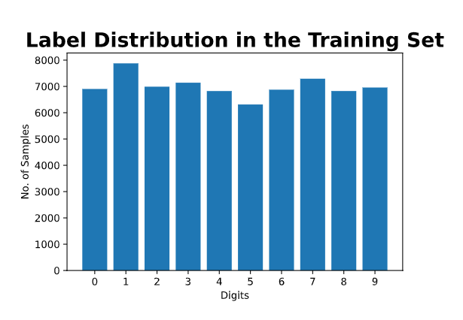
Machine Learning Model
Detecting a handwritten digit is a part of Supervised Machine Learning.
Supervised Machine Learning is that field of machine learning where we’ve a sufficient labeled dataset beforehand representing all the different possible scenarios & this is used to train our model. And the predictions made by our model depend upon this training dataset as the model looks for similar cases in the training dataset to predict a test set. The MNIST dataset is the training set used in this project.
Moreover, detecting handwritten digits is a Classification task. Classification is a part of Supervised Machine Learning in which the predictions to be made by model aren’t continuous values but is a task of identifying the class to which a particular test case belongs. Since there’re ten different digits 0-9, this is a Multiclass Classification Problem.
One of the most important requirements in a multiclass classification problem is to have equally divided training cases for all the different classes in the dataset. This requirement is fulfilled well by MNIST dataset which has a fair distribution of all the different digits in the training data as shown below.

Slide 7
Classification Models
The different Machine Learning Models for Classification tasks are:
Linear Classifier
K-Nearest Neighbors Classifier
Support Vector Machines (SVM)
Linear SVM
Kernelized SVM
Decision Trees
Random Forest Classifier

Slide 8
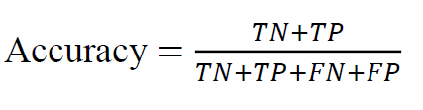
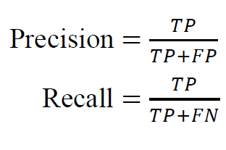
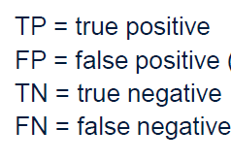
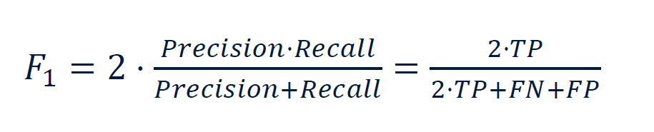
Evaluation Metrics
Accuracy Score: It’s simply the fraction of correct predictions made.
Recall: It’s known as the True Positive Rate & it’s calculated as the ratio of true positive predictions for a class to the sum of true positive & false negatives of that class. It’s important when the penalty of not identifying a true positive is very high even if that means more false positives.
Precision: It’s known as the False Positive Rate & it’s calculated as the ratio of false positive predictions for a class to the sum of true negatives & false positives of that class. It’s Important when the penalty of incorrectly identifying a test case as positive is very high.
F1 Score: It generalizes the precision & recall values into a single value. It’s an important metric for comparison as it signifies the Precision-Recall Tradeoff for a model.

Slide 9
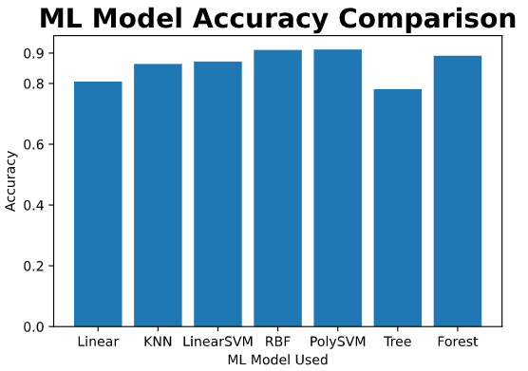
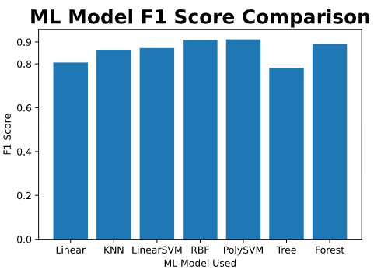
Model Analysis Results
According to the comparative analysis done in the first part of this project on different classification models whose results are shown above, we can observe that SVM classifiers produce the best results considering both accuracy & F1 score.
Further, it can be observed that the kernelized versions of SVM perform better than the linear SVM classifier.
Therefore, the RBF Kernelized version of SVM classifier has been selected for the detection of handwritten digits in the second part of the project.

Slide 10
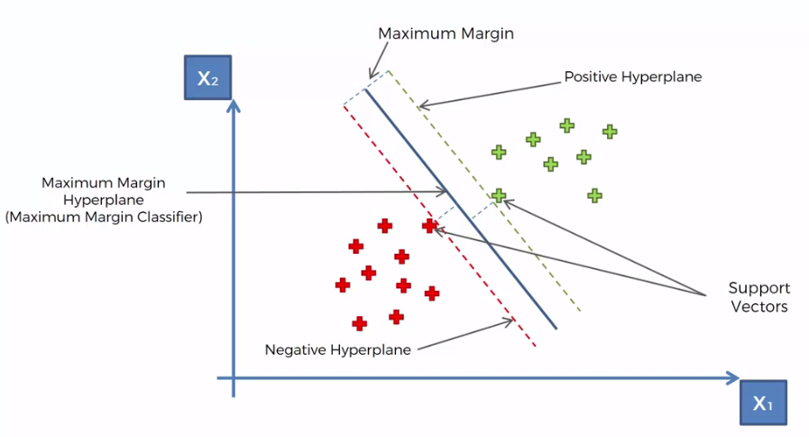
Support Vector Machines (SVM)
SVM are a class of supervised machine learning models which present one of the most robust prediction methods based on statistical learning framework. An SVM model is a representation of the training examples as points in space, mapped so that the examples of the separate categories are divided by a clear gap that is as wide as possible. New examples are then mapped into that same space and predicted to belong to a category based on the side of the gap on which they fall. It’s a non-probabilistic classifier which means, frequency of class labels in training data add no weight in predictions.

Slide 11
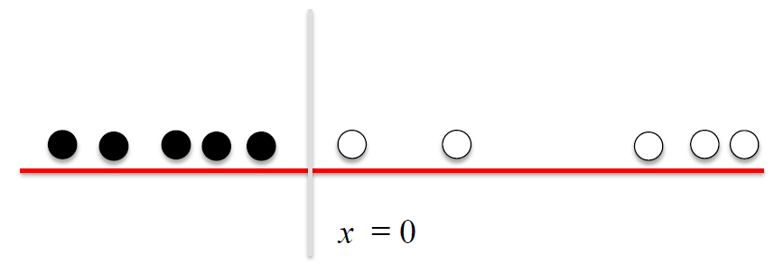
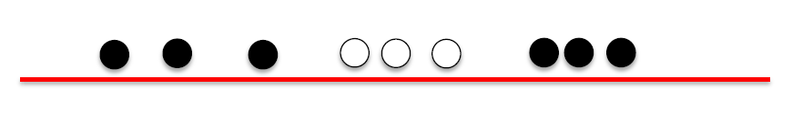
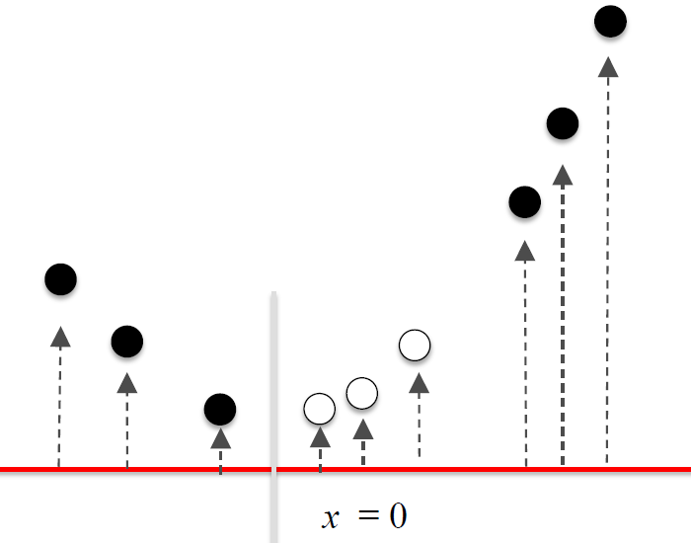
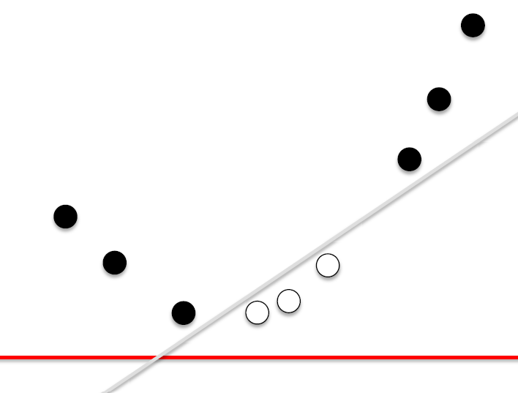
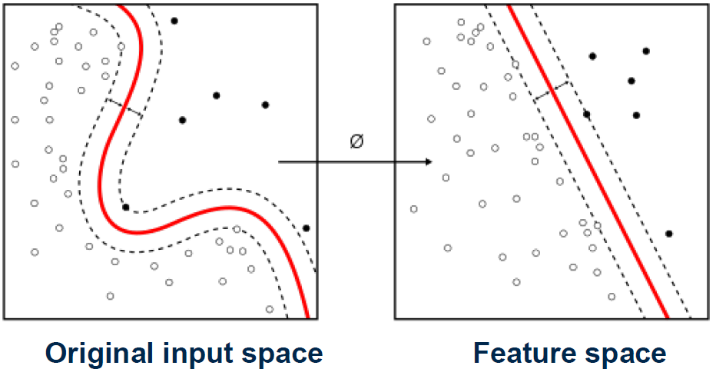
Radial Basis Function (RBF) Kernel
Kernels are used in SVM when the training data set is complex & isn’t linearly separable. RBF kernel is a transformer which generates new features by measuring the distance between all other features to the dot centers & using these new features it generates a complex & non-linear decision boundary between the different classes which helps to improve accuracy in complex prediction tasks. Since MNIST dataset is a large & complex database therefore, RBF kernelized SVM works well when applied on it.

Slide 12
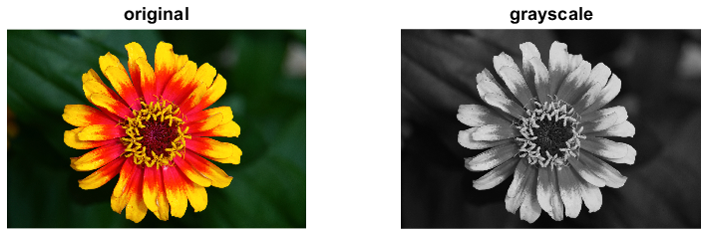
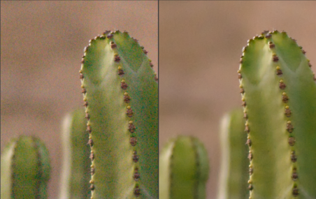
Image Pre-Processing
For feeding an image to the HOG feature extractor, it first has to undergo several pre-processing operations to make it suitable for the HOG extraction. Pre-Processing of an image is necessary for several reasons such as:
HOG feature extraction works only on Grayscale images, therefore colored images have to be converted to grayscale.
Pre-processing is necessary to remove unwanted Noise in the image background. This noise might induce random variations in feature extraction process & therefore produce inaccurate predictions. Noise reduction in an image helps to make it smoother especially over the edges and therefore the edge detection improves.

Slide 13
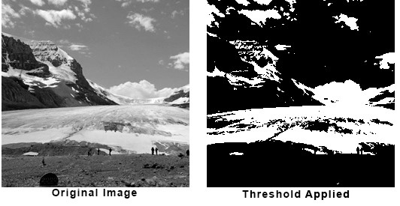


Image Pre-Processing
Thresholding is an important part of image pre-processing. It divides the image into two regions of higher & lower intensities depending on their initial intensity & the threshold value used. This helps to clearly define the boundaries of intensity change which mostly correspond to edges of an object. Therefore, edge detection becomes more accurate and less time consuming.
Dilating is another important part of pre-processing as it helps to increase the area of main object in the image & makes it smoother. This makes the job easy for the feature extractor & improves accuracy.
Finally, the image is Resized. Since the image has to be further divided into square cells & blocks, therefore it has to be resized proportionally including the object completely.
These operations are performed in OpenCV using functions like Gaussian Blur, Threshold, Dilate, resize etc.

Slide 14
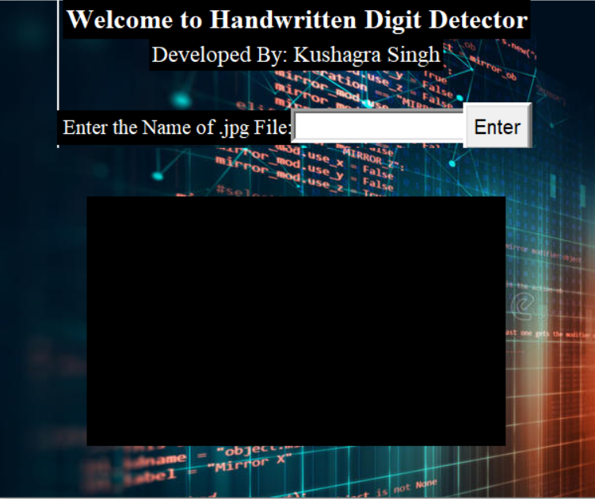
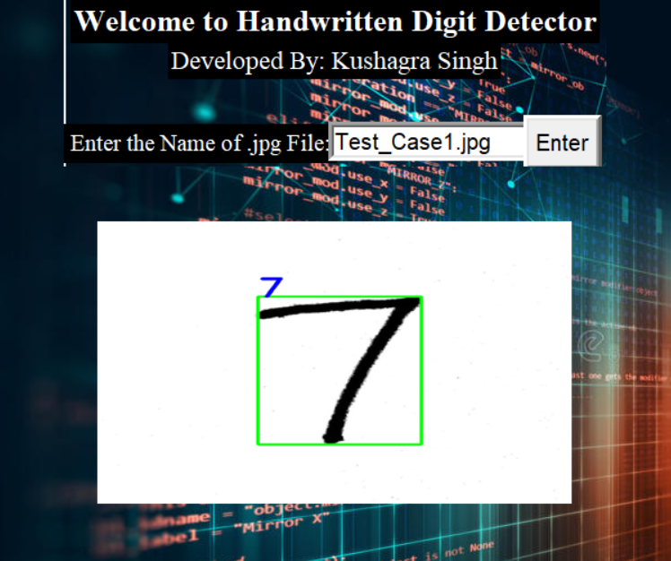
Implementation Result

Slide 15




Python Libraries Used
For Data Processing & Manipulation
For Data Visualization
Provides Machine Learning Models, Algorithms & Evaluation Metrics
For the Application GUI

Slide 16
References
LeCun Y.1998. The MNIST database of handwritten digits. http://yann.lecun.com/exdb/mnist/
Deng, L., 2012. The MNIST database of handwritten digit images for machine learning research. IEEE Signal Processing Magazine, 29(6), pp.141-142.
Liu, C.L., Nakashima, K., Sako, H. and Fujisawa, H., 2004. Handwritten Digit Recognition: Investigation of Normalization and Feature Extraction Techniques. The Journal of Pattern Recognition Society, 37(2), pp.265-279.
Ebrahimzadeh, R. and Jampour, M., 2014. Efficient handwritten digit recognition based on histogram of oriented gradients and SVM. International Journal of Computer Applications, 104(9).
Lawgali, A. (2016). Recognition of Handwritten Digits using Histogram of Oriented Gradients. International Journal of Advances Research in Science, Engineering and Technology, 3, 2359-2363.
Dalal, N., & Triggs, B. (2005, June). Histograms of Oriented Gradients for human detection. In Computer Vision and Pattern Recognition, 2005. CVPR 2005. IEEE Computer Society Conference on (Vol. 1, pp. 886-893). IEEE
Blog Post on Histogram of Oriented Gradients by Satya Mallik. https://www.learnopencv.com/histogram-of-oriented-gradients/

